Slide 1


Universidade Federal de Alagoas
Instituto de computação
Programa de Pós-Graduação em Informática - PPGI
Code smell agreement aided by a decision tree classifier
Master Student: Christiano Rossini Martins Costa
Advisor: Baldoino Fonseca dos Santos Neto

Slide 2
Research status
Conception
Experiment
Implement artifacts
pilot execution
execution
Analysis
Discussions

Slide 3
Code Smells
Code smells
Design flaw
Affects
Comprehensibility
Increase of change and fault proneness
Maintanability
Detection of code smell by developer
Subjectivive
Sensitive to perception
Experiences
background

Slide 4
Automated CS detection
Automated code smell detection
Tools (static Thresholds)
Detection with Machine learning Techiniques
Supervised Learning to detect code smells
Decision trees
Good effectivity
Interpretable
Detections rules are visible and compreensible

Slide 5
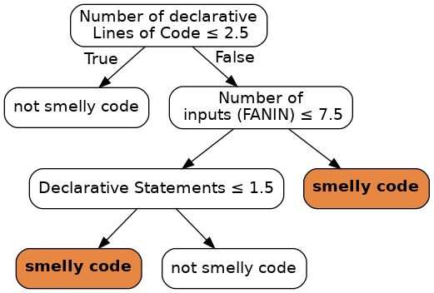
Interpretable ML technique to support code smell detection
White box classifier:
Ex.: decision tree
A guided approach to detect a smell
Nodes = metrics
A tool for decision support

Slide 6
General objective
Assess code smell detection agreement, when the process is carried out aided by a decision tree classifier

Slide 7
Specific objectives
Discover a code smell detection aided by a decision tree contributes to a more convergent (agreement) or divergent (disagrement) detections.
Discover if a decision tree insights play a role on developer's confidence
Level of confidence
Discover if decision tree support influences the effort to detect a certain code smell type.
Time required to detect a code smell

Slide 8
Study context
Code smell (CS) type selection
Types:
Class scoped (3):
God class (GC)
Middle Man (MM)
Class Data should be private (CDSBP)
Method scoped (2):
Long method (LM)
Long Parameter List (LPL)
Selection criteria:
Previous works about code smell detection, from CS with worst agreement (or perception) to CS with best agreement (or perception)
Smely code dataset
A manually validated code smell from Palomba et. Al

Slide 9
Study context
Independent variables (features)
Software metrics
Class metrics
Method metrics
Metrics categories (source code scope)
Complexity
Size
Coupling
Cohesion
inheritance
Metrics source: Scitool's Understand

Slide 10
Study context
Participants
Academy
Industry
Survey
Custom Web-based Survey, built upon Django framework
Supervised learning
Decision tree (DT) Classifier
Python Sklearn API
C.A.R.T. implementation of DT
Spliting criterion:
Options
Entropy
Gini Index
Selected: Gini Index (most effective)

Slide 11
Study design
Research questions
RQ1: To what extent an aided aproach of code smell detection - using a tree classifier – influences in developer's agreement about certain code smell?
RQ2: How much effort do developer spend during code smell detection with a tree classifier support?
RQ3: What is the confidence level after a code smell detection with a tree classifier support?

Slide 12
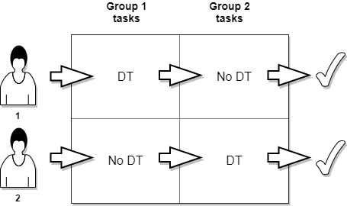
Study design
Latim square design

Slide 13
Study design
Latim square design
Blocking factors
Participants:
Participant 1 and Participant 2
Tasks Group
Task Group 1 and Task Group 2 = a set of code snippets (1 task=1code snippet)
Code smell scope | Code Smell type
Class-scoped CS tasks and Method-scoped CS tasks | God Class Middle man Refused bequest Long method Long parameter list Feature envy

Slide 14
Study design
Latim square design
Treatments
DT – source code analysis aided by a decision tree classifier
Number or leaves: between 4 and 6
Tree Depth: between 2 and 4
No DT – source code analysis NOT aided by a decision tree classifier

Slide 15
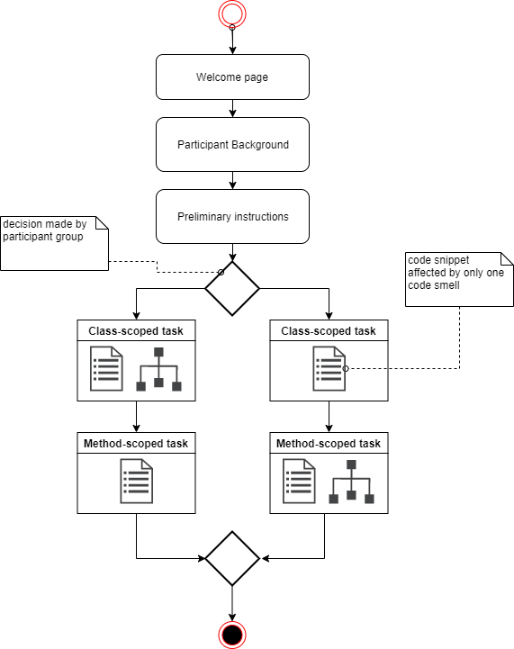
Study procedure
web survey flow

Slide 16
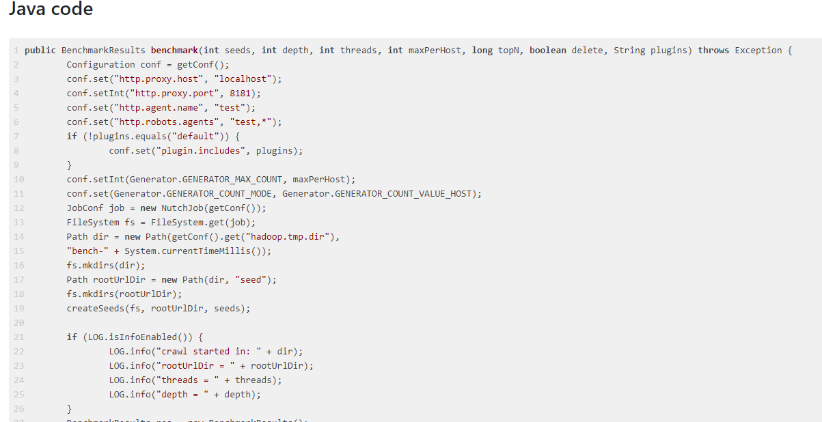
Study procedure
Code snippet view

Slide 17
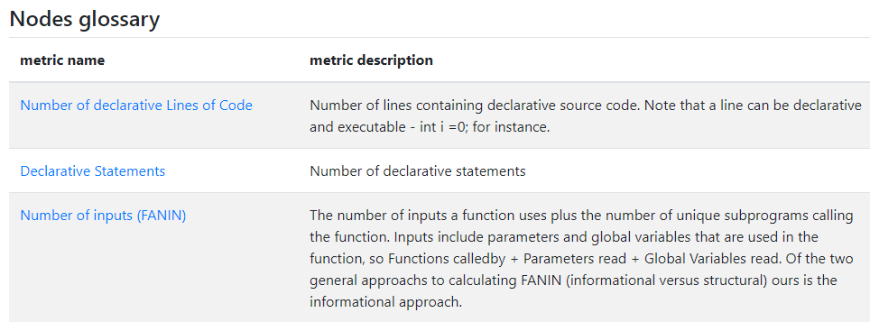
Study procedure
Tree view

Slide 18
Study procedure – Task submission
"GOD CLASS - A large class implementing different responsibilities and centralizing most of the system processing."
1º - set the agreement level
2º - explain

Slide 19
Study procedure – Task submission
1º - set the level of agreement
Strongly Agree
Agree
Undecided
Disagree
Strongly Disagree
Likert Scale

Slide 20
References
[1]Marwen Abbes, Foutse Khomh, Yann-Gael Gueheneuc, and Giuliano Antoniol.2011. An empirical study of the impact of two antipatterns, blob and spaghetticode, on program comprehension. InSoftware maintenance and reengineering(CSMR), 2011 15th European conference on. IEEE, 181–190.
[2]Dario Di Nucci, Fabio Palomba, Damian A Tamburri, Alexander Serebrenik, andAndrea De Lucia. 2018. Detecting code smells using machine learning techniques:are we there yet?. In2018 IEEE 25th International Conference on Software Analysis,Evolution and Reengineering (SANER). IEEE, 612–621.
[3]Francesca Arcelli Fontana, Pietro Braione, and Marco Zanoni. 2012. Automaticdetection of bad smells in code: An experimental assessment.Journal of ObjectTechnology11, 2 (2012), 5–1.
[4]Francesca Arcelli Fontana, Vincenzo Ferme, Alessandro Marino, Bartosz Walter,and Pawel Martenka. 2013. Investigating the impact of code smells on system’squality: An empirical study on systems of different application domains. InSoftware Maintenance (ICSM), 2013 29th IEEE International Conference on. IEEE,260–269.
[5]Francesca Arcelli Fontana, Mika V Mäntylä, Marco Zanoni, and AlessandroMarino. 2016. Comparing and experimenting machine learning techniques forcode smell detection.Empirical Software Engineering21, 3 (2016), 1143–1191.
[6]Francesca Arcelli Fontana, Marco Zanoni, Alessandro Marino, and Mika VMantyla. 2013. Code smell detection: Towards a machine learning-based ap-proach. InSoftware Maintenance (ICSM), 2013 29th IEEE International Conferenceon. IEEE, 396–399.
[7] Martin Fowler, Kent Beck, John Brant, William Opdyke, and Don Roberts. 1999.Refactoring: improving the design of existing code. Addison-Wesley Professional.[8]Bryce Goodman and Seth Flaxman. 2016. European Union regulations on algorith-mic decision-making and a" right to explanation".arXiv preprint arXiv:1606.08813(2016).
[9]Mário Hozano, Alessandro Garcia, Baldoino Fonseca, and Evandro Costa. 2018.Are you smelling it? Investigating how similar developers detect code smells.Information and Software Technology93 (2018), 130–146.
[10]Abdou Maiga, Nasir Ali, Neelesh Bhattacharya, Aminata Sabane, Yann-GaelGueheneuc, and Esma Aimeur. 2012. SMURF: A SVM-based incremental anti-pattern detection approach. InReverse engineering (WCRE), 2012 19th workingconference on. IEEE, 466–475.
[11]Abdou Maiga, Nasir Ali, Neelesh Bhattacharya, Aminata Sabané, Yann-GaëlGuéhéneuc, Giuliano Antoniol, and Esma Aïmeur. 2012. Support vector ma-chines for anti-pattern detection. InAutomated Software Engineering (ASE), 2012Proceedings of the 27th IEEE/ACM International Conference on. IEEE, 278–281.
[12]Willian Oizumi, Alessandro Garcia, Leonardo da Silva Sousa, Bruno Cafeo, andYixue Zhao. 2016. Code anomalies flock together: Exploring code anomalyagglomerations for locating design problems. InSoftware Engineering (ICSE), 2016IEEE/ACM 38th International Conference on. IEEE, 440–451.
[13]Fabio Palomba, Gabriele Bavota, Massimiliano Di Penta, Rocco Oliveto, and An-drea De Lucia. 2014. Do they really smell bad? a study on developers’ perceptionof bad code smells. In2014 IEEE International Conference on Software Maintenanceand Evolution. IEEE, 101–110.[14]Marco Tulio Ribeiro, Sameer Singh, and Carlos Guestrin. 2016. Model-agnosticinterpretability of machine learning.arXiv preprint arXiv:1606.05386(2016).

